Slide 1
Shertonia Stanley
12-6-2017
CST-105
Lisa Hebert

Slide 2
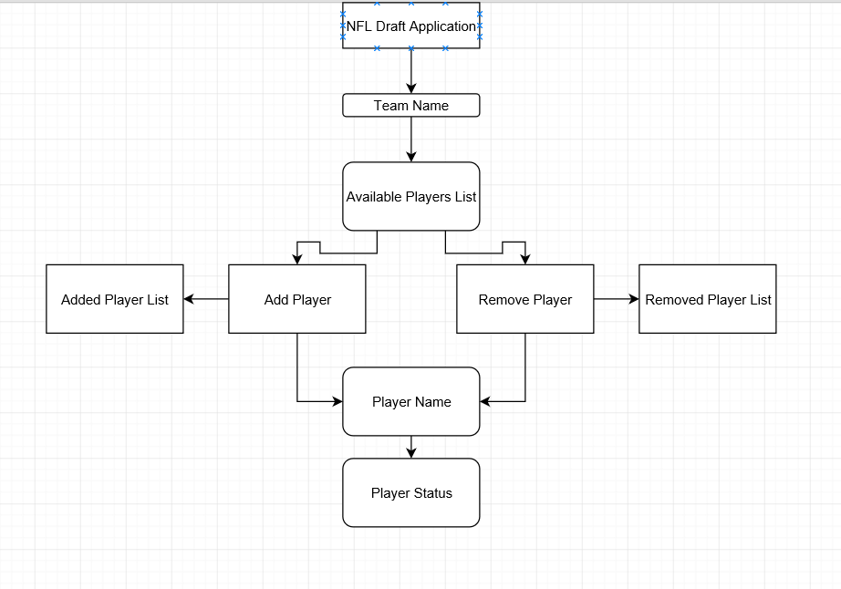
NFL Draft Application Storyboard

Slide 3
How a storyboard is related to programming
A storyboard is another way of being an organizer that is graphical viewers are provided with a higher view level of the project.
A storyboard can also show the developers what work still needs to be completed.
It will helps the team to visualize through interconnectedness and sequence.

Slide 4
Reference:
Knapp, J. (2017, May 02). The 8 Steps To Creating A Great Storyboard. Retrieved December 04, 2017, from https://www.fastcodesign.com/1672917/the-8-steps-to-creating-a-great-storyboard

